Slide 1
Battle of Neighborhoods Starting up a business in Fitness Industry in Central London
Applied Data Science Capstone Project
Ashish Nagpal

Slide 2
The Problem
An on-growing fitness industry for decades
The business is to cater to fitness needs of the people – fitness equipment (personal and commercial), clothing, supplements and other accessories.
Seeks interest of entrepreneurs or businesspeople looking to enter the fitness industry
Location to start this business in Central London?

Slide 3
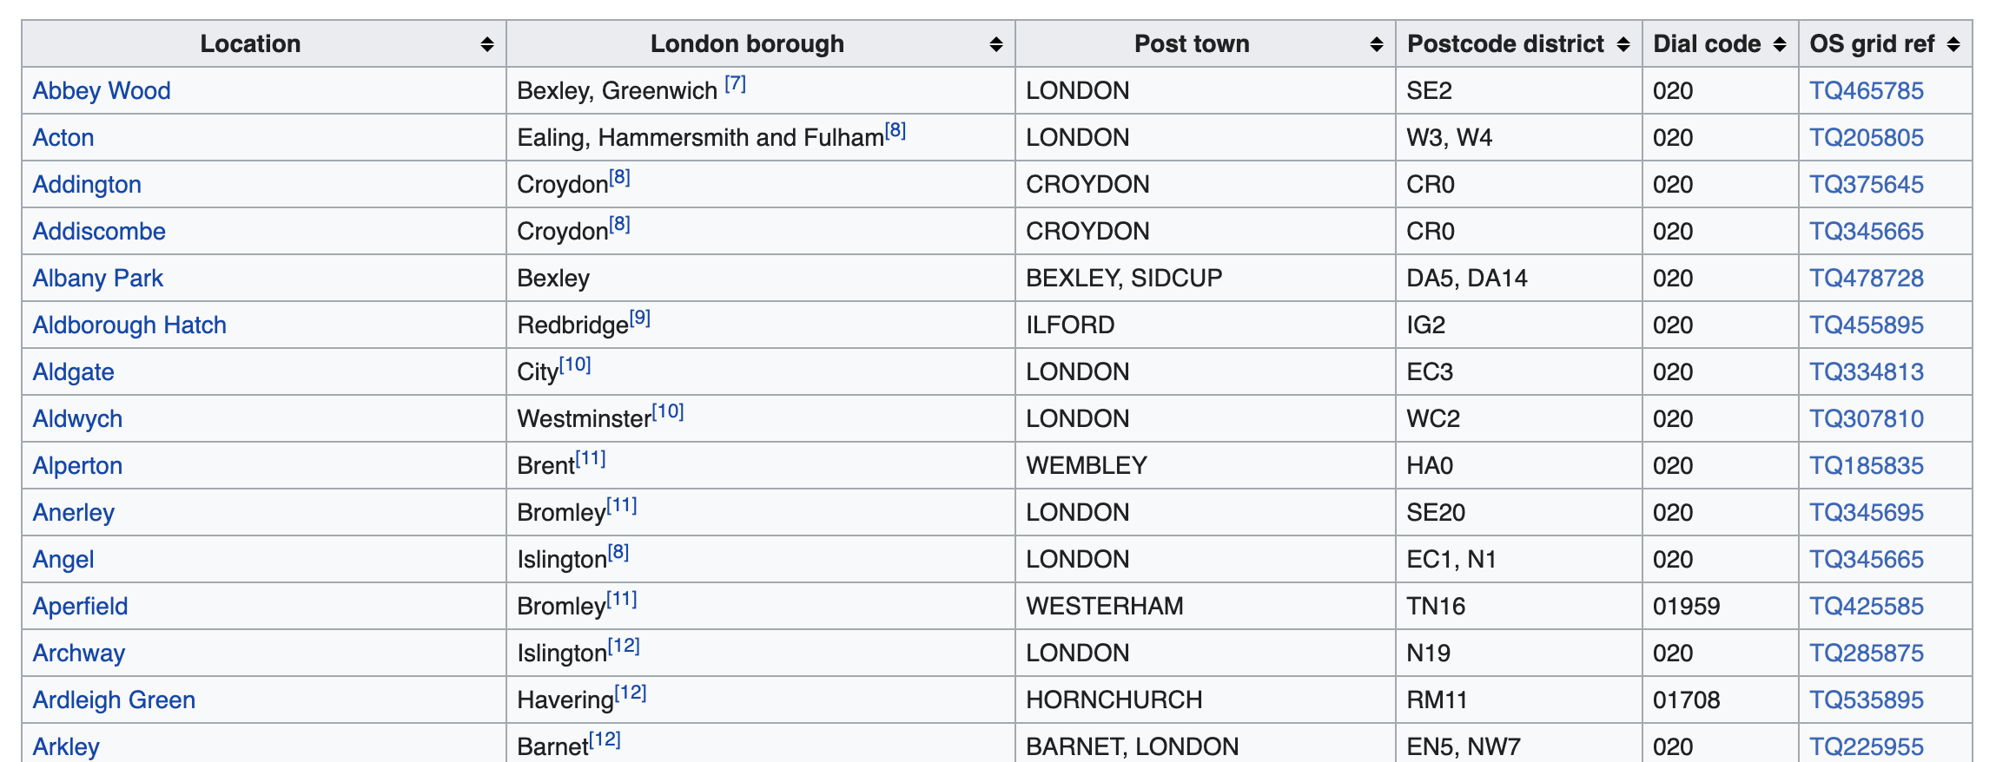
Data Acquisition
List of Neighborhoods in London, England from Wikipedia page https://en.wikipedia.org/wiki/List_of_areas_of_London
London Neighborhoods Data

Slide 4
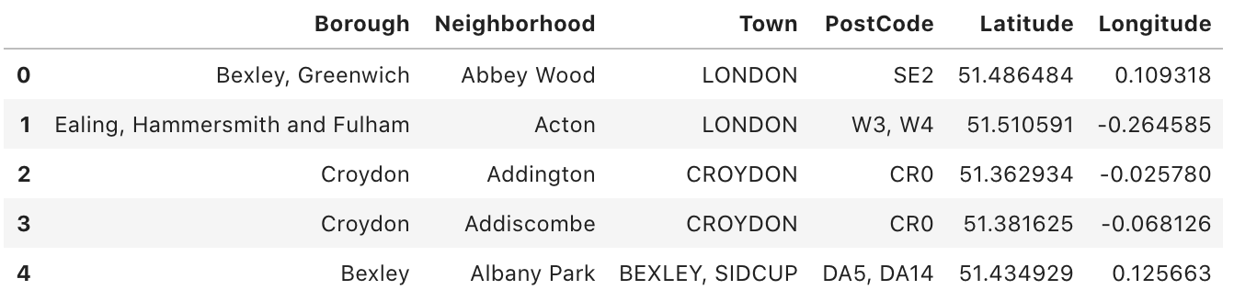
Data Cleaning
London Neighborhoods Data
Changing Column Names
Removing unnecessary Values such as numbered citations
Converting OS grid ref to geographical coordinates
Dropping irrelevant columns

Slide 5
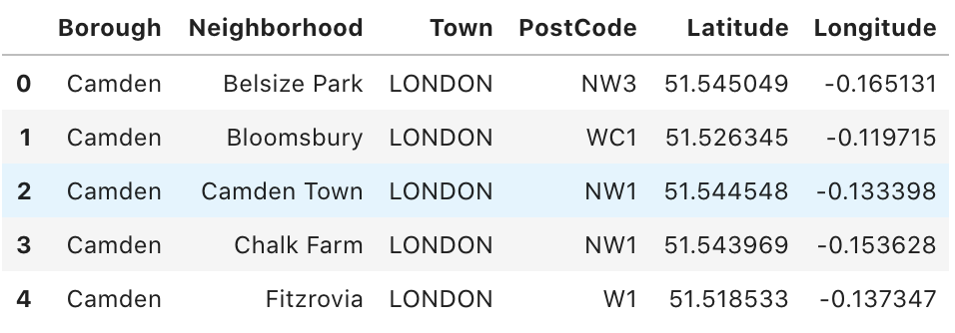
Data Slicing – Borough
Use the London Neighborhoods Data to slice the Boroughs included in Central London, as per information available here https://en.wikipedia.org/wiki/Central_London
Central London Neighborhoods Data

Slide 6
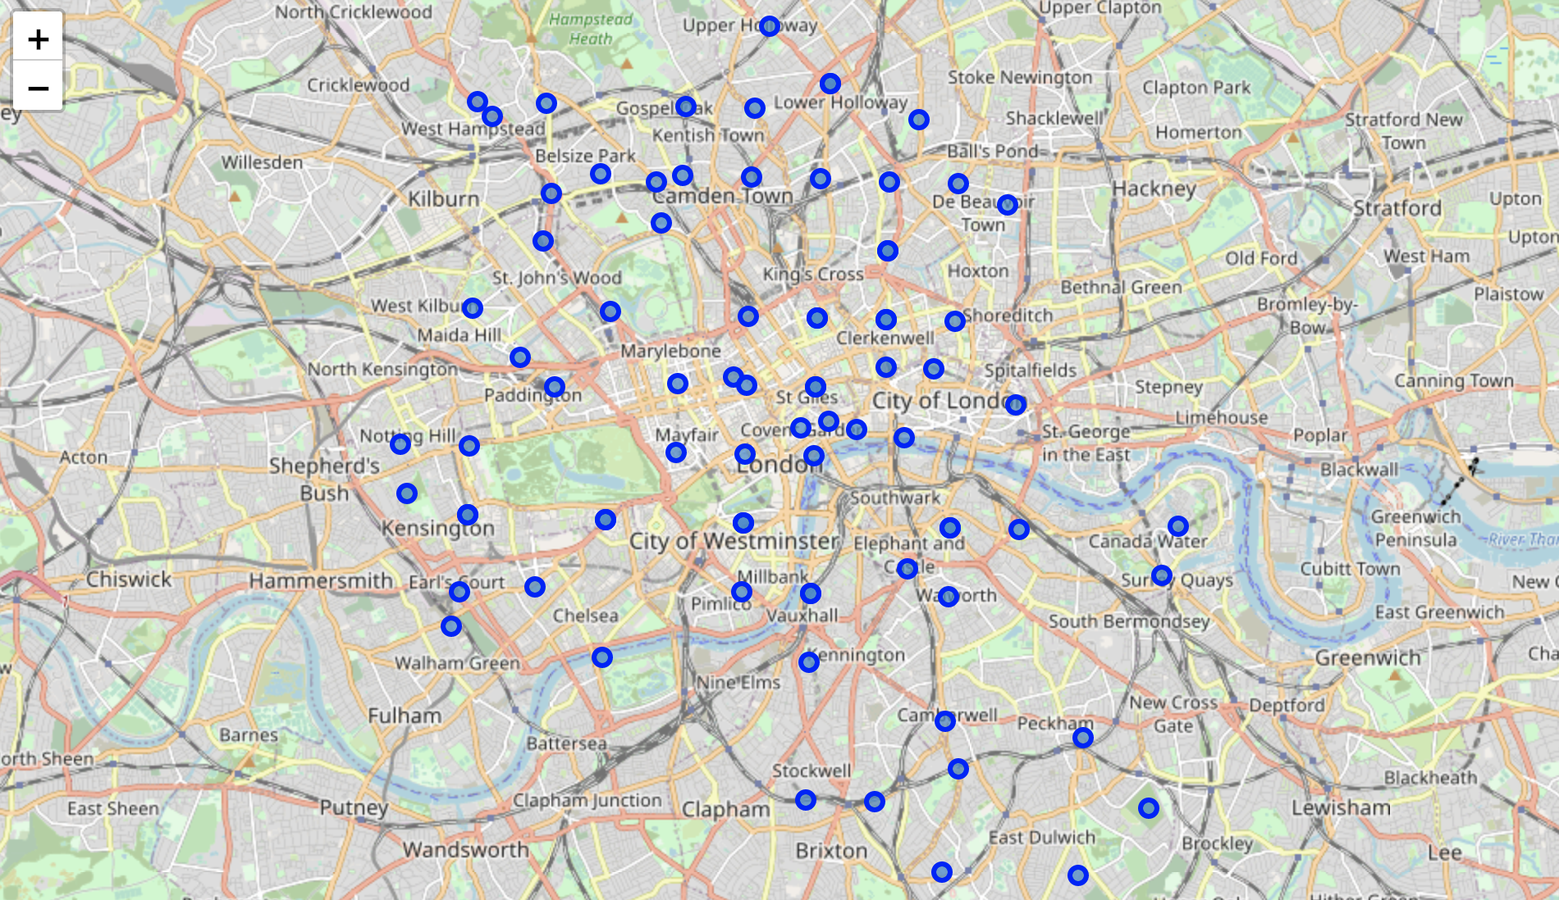
Map Plotting - Neighborhoods
All Neighborhoods of Central London plotted using Folium

Slide 7
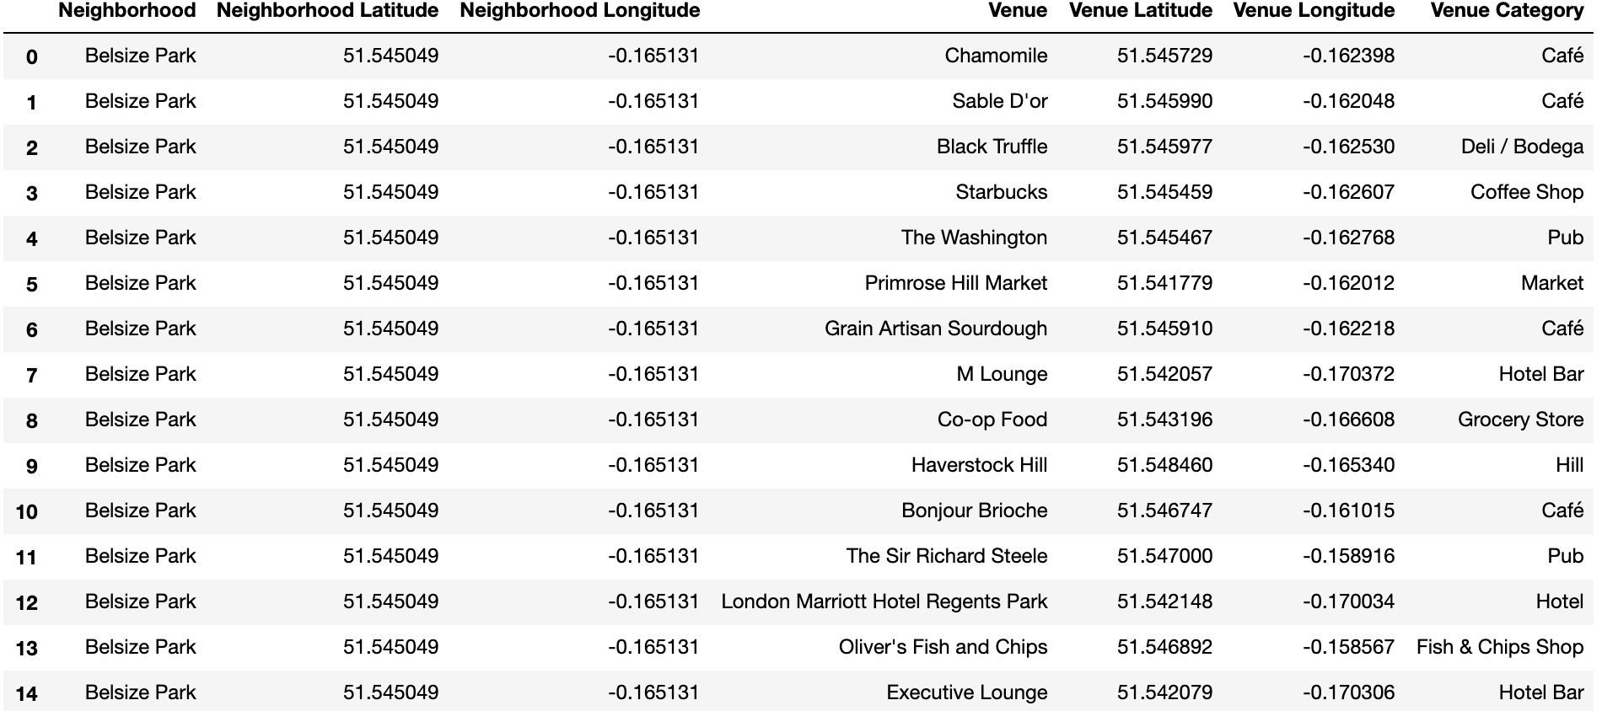
Using Foursquare API
Get top 100 venues and its respective category in all neighborhoods in Central London using geographical coordinates

Slide 8
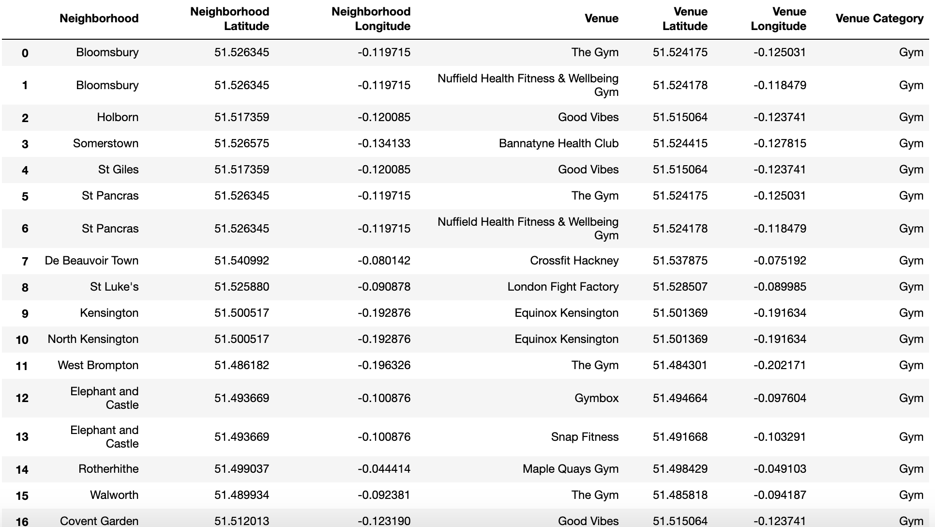
Data Slicing- Venue Category
All Venues with categories 'Gym', 'Gym / Fitness Center', 'Gym Pool', 'Gymnastics Gym’ sliced

Slide 9
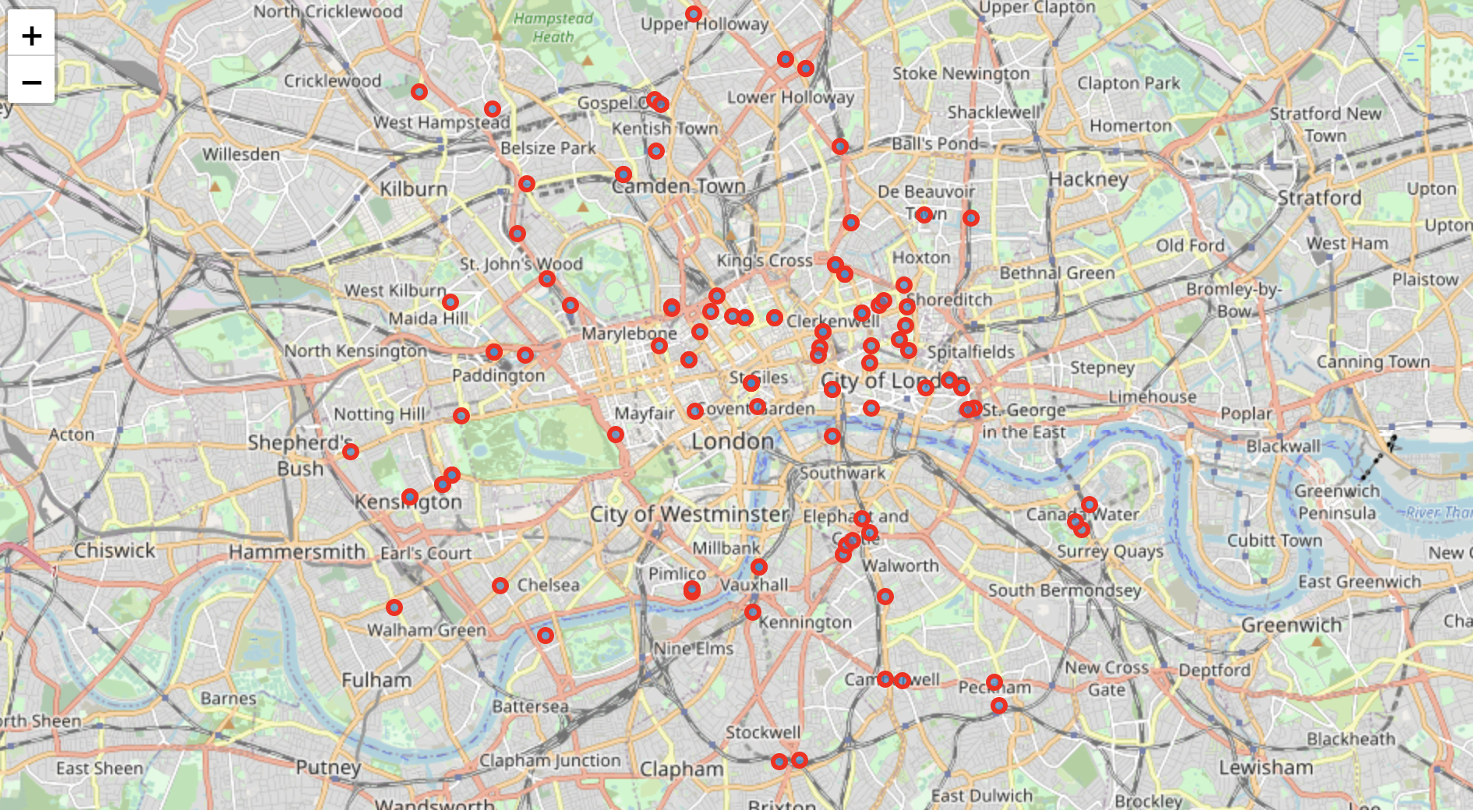
Map Plotting – Gyms
All gyms plotted on Folium Map

Slide 10
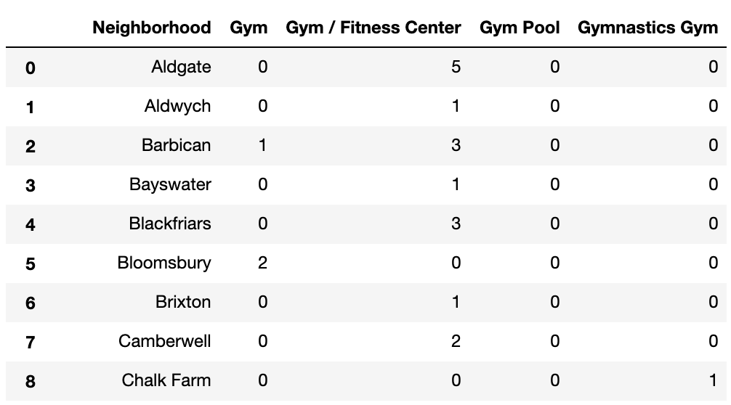
Data Analysis
One hot coding performed to analyze each neighborhood with its number of gyms

Slide 11
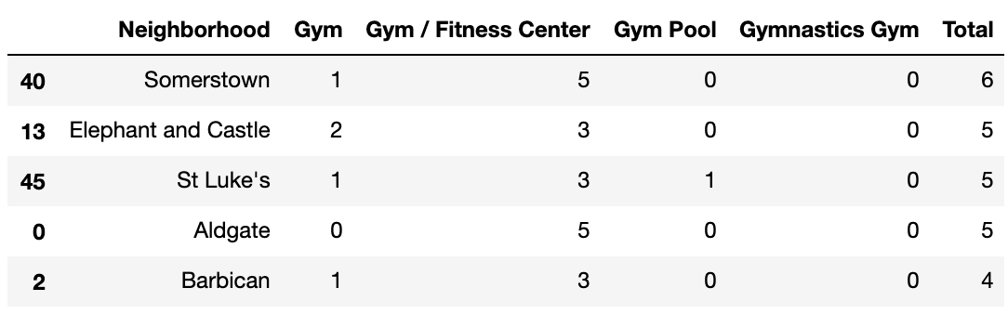
Data Grouping
Grouped in descending order, the neighborhood with most gyms at the top
These are the top 5 neighborhoods for potential business location

Slide 12
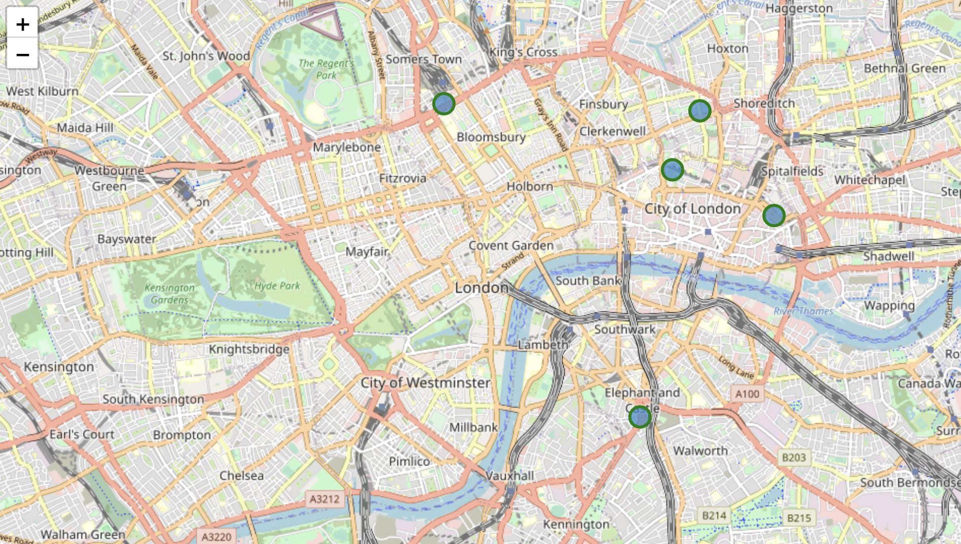
Result
Top 5 Potential Locations Plotted using Folium

